Slide 1
Real-time EEG Classification for Motor imagery based BCI Applications

Slide 2
Submitted By:
Fahim Abdullah
Roll:161020221
Supervised By:
Dr. Md. Sujan Ali
Professor,
Dept. Of CSE,
JKKNIU.

Slide 3
Overview
What is Motor Imagery
What we are trying to do
Where the problem lies
Objectives & Application
Used Technology
Methodology
Dataset & Classifiers
Interface
Future works & Conclusion

Slide 4
What is Motor Imagery ?
Motor imagery (MI) refers to the mental simulation of body movements.
With motor imagery subject thinks about doing a task without actually doing it.
Motor Imagery data is collected from the surface of the brain or from the scalp using Electroencephalography (EEG).

Slide 5
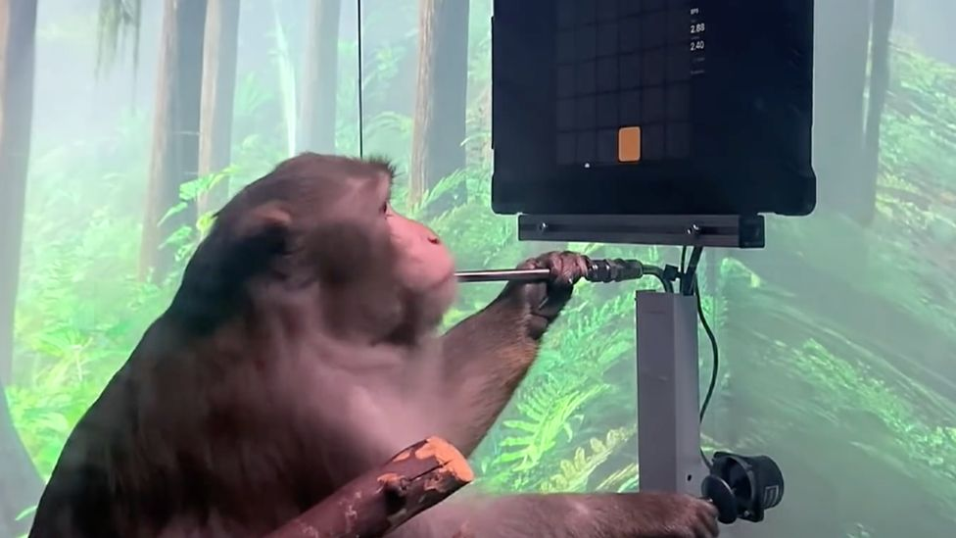
Motor Imagery based BCI
The motor imagery (MI)-based brain-computer interface (BCI) is an intuitive interface that provides control over computer applications directly from brain activity.
When Computer takes its command directly from the brain of the user.

Slide 6
What we are trying to do.
To develop a desktop application which tries to classify continuous EEG signal of various Motor imagery tasks and non motor imagery state.

Slide 7
Where The problem Lies?
The brain signals are noisy.
The variation of signal in different tasks is often very small and hard to classify.
Collecting the EEG data can be a challenging task.
Processing real time continuous data

Slide 8
Objectives
Find the most suitable algorithms for motor imagery classification.
Apply machine learning models in the application.
Test application with available data.
Result Analysis.

Slide 9
Application
Brain computer interface(BCI)
Better prosthetic control for disabled persons.
Research purposes.

Slide 10
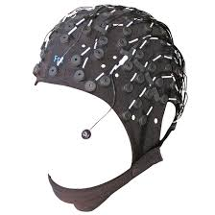
Methodology
EEG Recording
Preprocessing
MI/ no MI classifier
MI : Motor imagary
Fig: Motor imagery classification for EEG
MI Classification
10

Slide 11
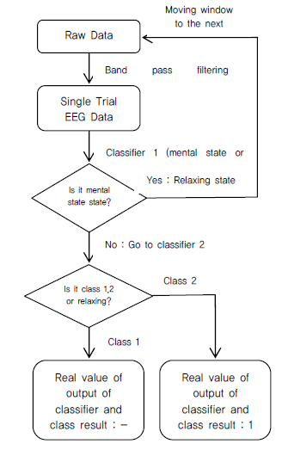
Methodology

Slide 12
Dataset
The dataset we have decided to use is the Data set 1 of BCI Competition IV.
Consists of two different motor imagery tasks,
imagination of movement of the left hand (class 1),
right hand (class2),
There are 200 trials, each class with 100 trials.
continuous signals of 59 EEG channels.
Sampling rate 100hz

Slide 13
Data Description
Cues were displayed for a period of 4s during which the subject was instructed to perform the cued motor imagery task.
These periods were interleaved with 2s of blank screen and 2s with a fixation cross shown in the center of the screen
Timing scheme of the paradigm
Blank Screen
MI task performed
Fixation cross
0 2 6 8

Slide 14
Feature Extraction
Common spatial pattern (CSP)
CSP is a mathematical procedure used in signal processing for separating a multivariate signal into subcomponents which have maximum differences in variance.
Recently there has been a method developed to implement CSP for Multiclass data.

Slide 15
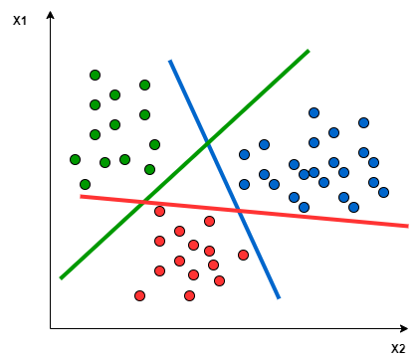
Classifiers
SVM(Support Vector Machine)
create the best line or decision boundary that can segregate n-dimensional space into classes

Slide 16


Result Representation
Accuracy:
Percentage of correct prediction
Kappa Score
Account the possibility of the agreement occurring by chance.

Slide 17
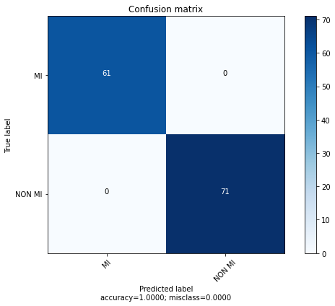
Results(MI/NO MI Classifier)

Slide 18
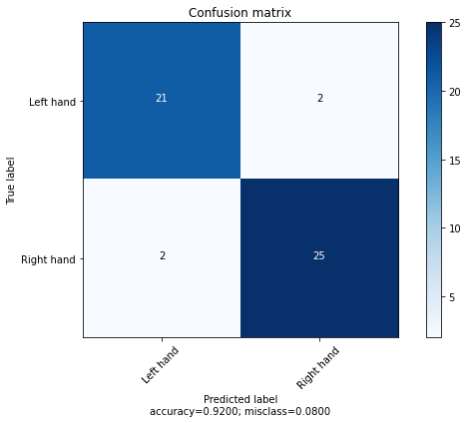
Results(MI Classifier)

Slide 19
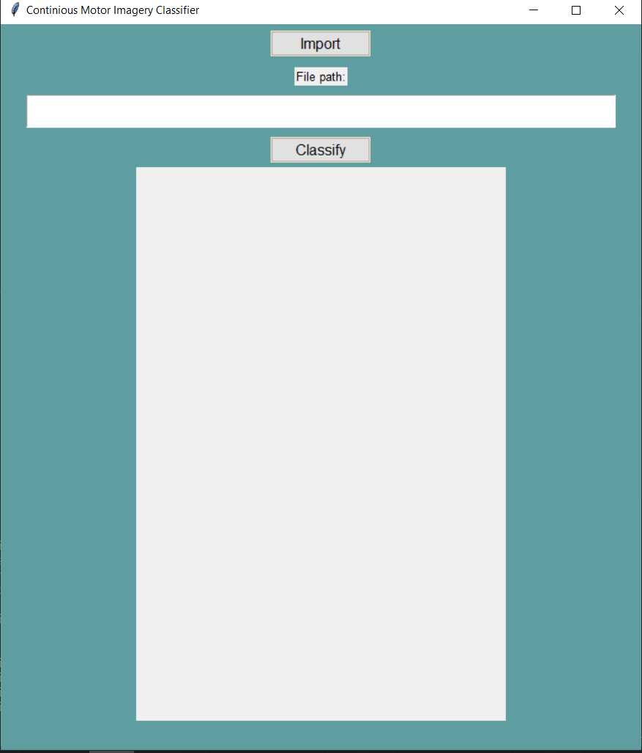
Application Interface Opening Interface

Slide 20
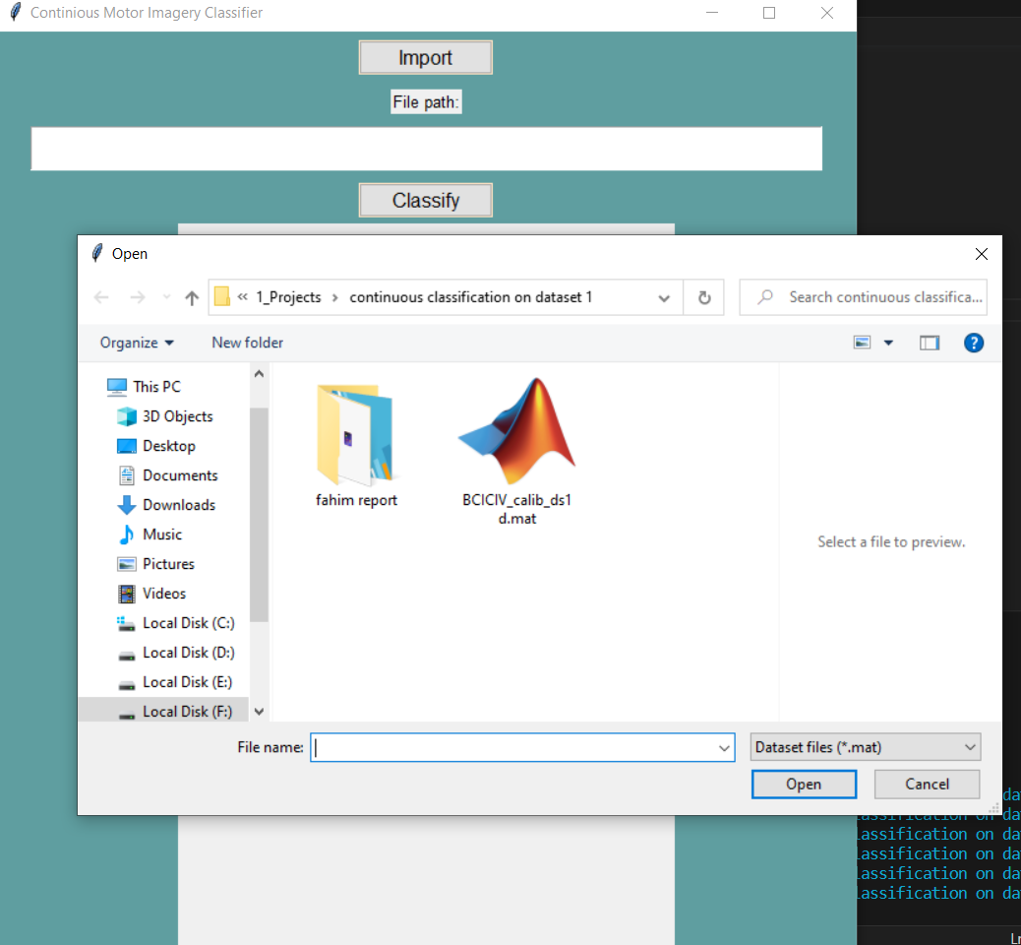
Application Interface Dataset selecting Interface

Slide 21
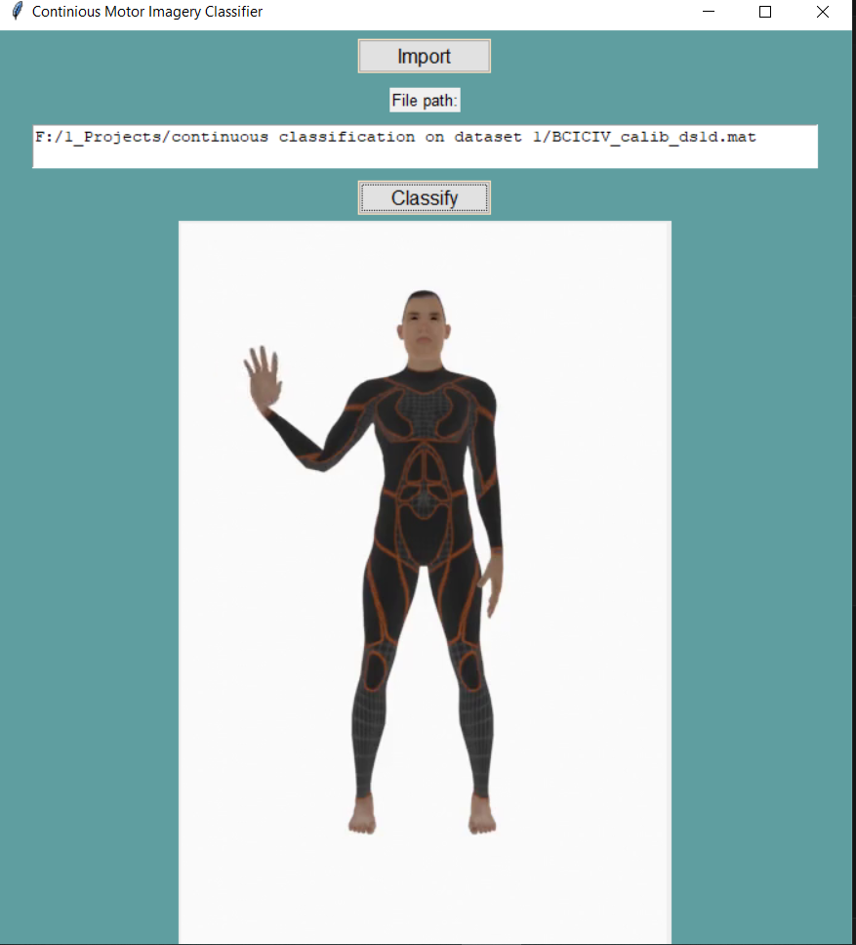
Waving left hand

Slide 22
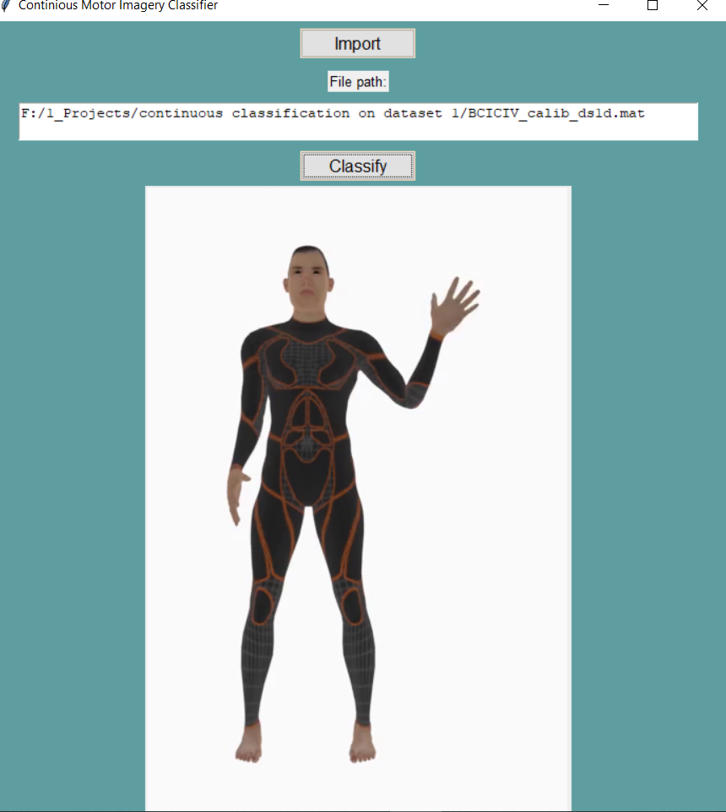
Waving right hand

Slide 23
Future works
recognition of individual trails to control prosthetics or other devices.
improve the accuracy of the classifiers
studying more experiment paradigms, processing and classification algorithms.

Slide 24
Any Questions ?

Slide 25
Thank You

